Slide 1
3rd – 9th March 2025
A week-long celebration of community repair.
Supporting residents to find local repairers and inspiring them to fix instead of throwing away.

Slide 2
Recycling is good…
but we can do more
We need to rethink our consumption habits and make a more resource efficient circular economy.
Making things generates planet harming emissions that impact our air, water and health. And depletes valuable resources like copper, lithium and cobalt which we’re running out of.
Reducing the amount of stuff we buy decreases harmful emissions, minimises waste, and protects resources.
Repairing our things helps them last longer and reduces the need to buy new stuff.
Repair helps to take a step towards a more circular economy which is critical to meet our climate change targets.
Repair also provides opportunities for new skills and training, essential for closing the green skills gap and changing behaviour.

Slide 3
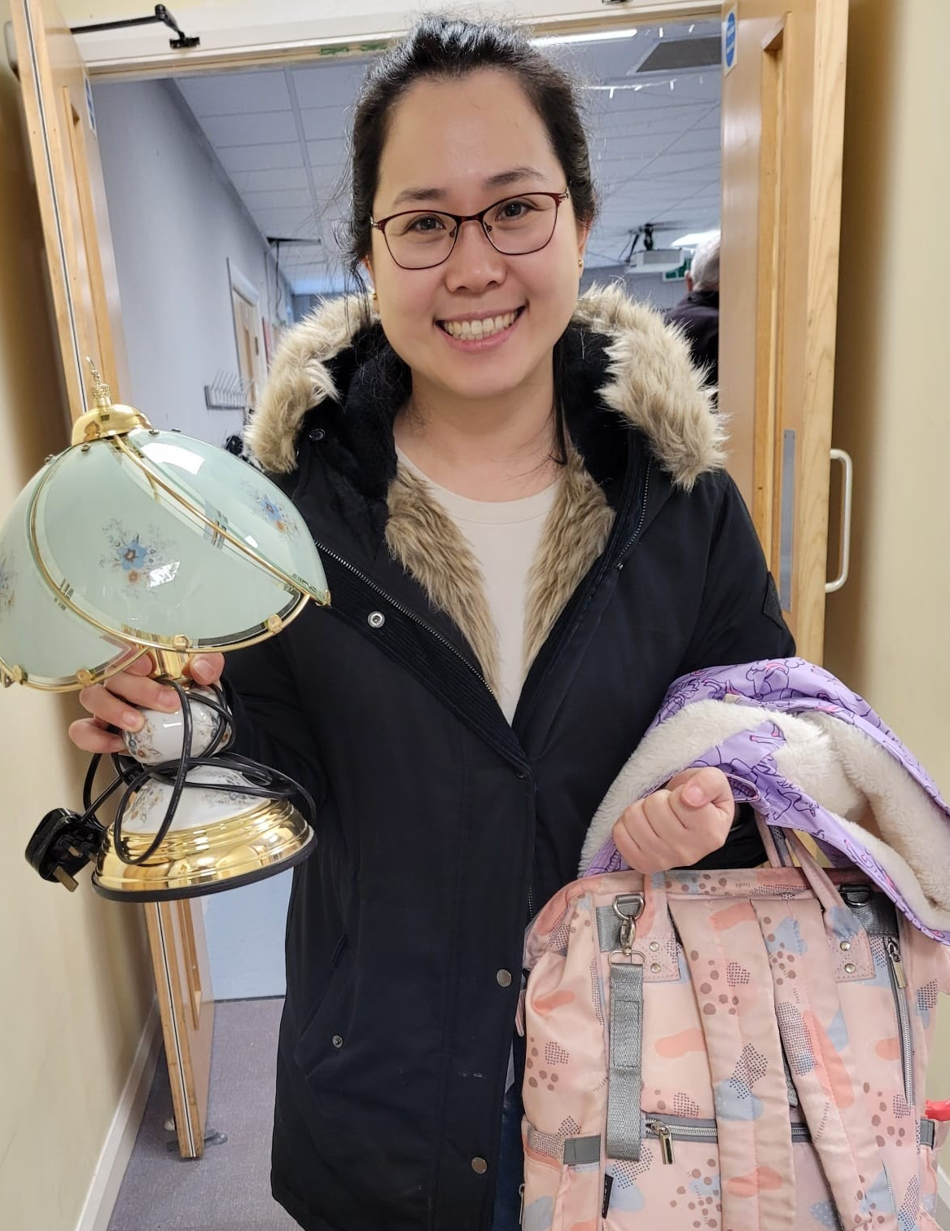
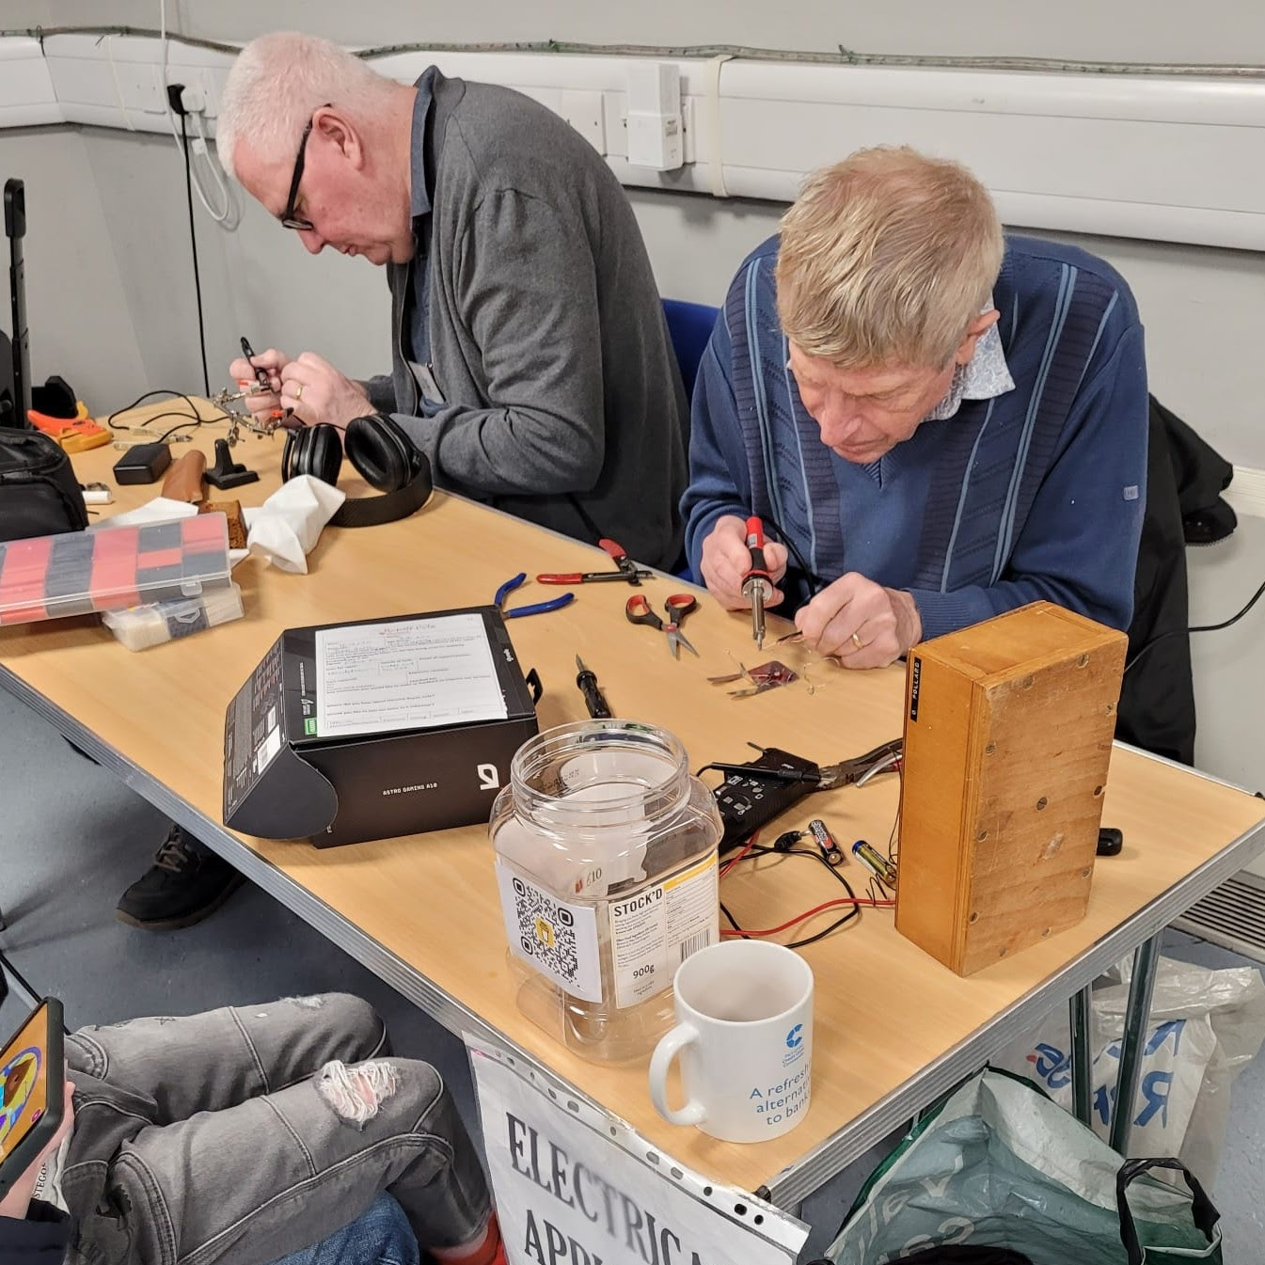
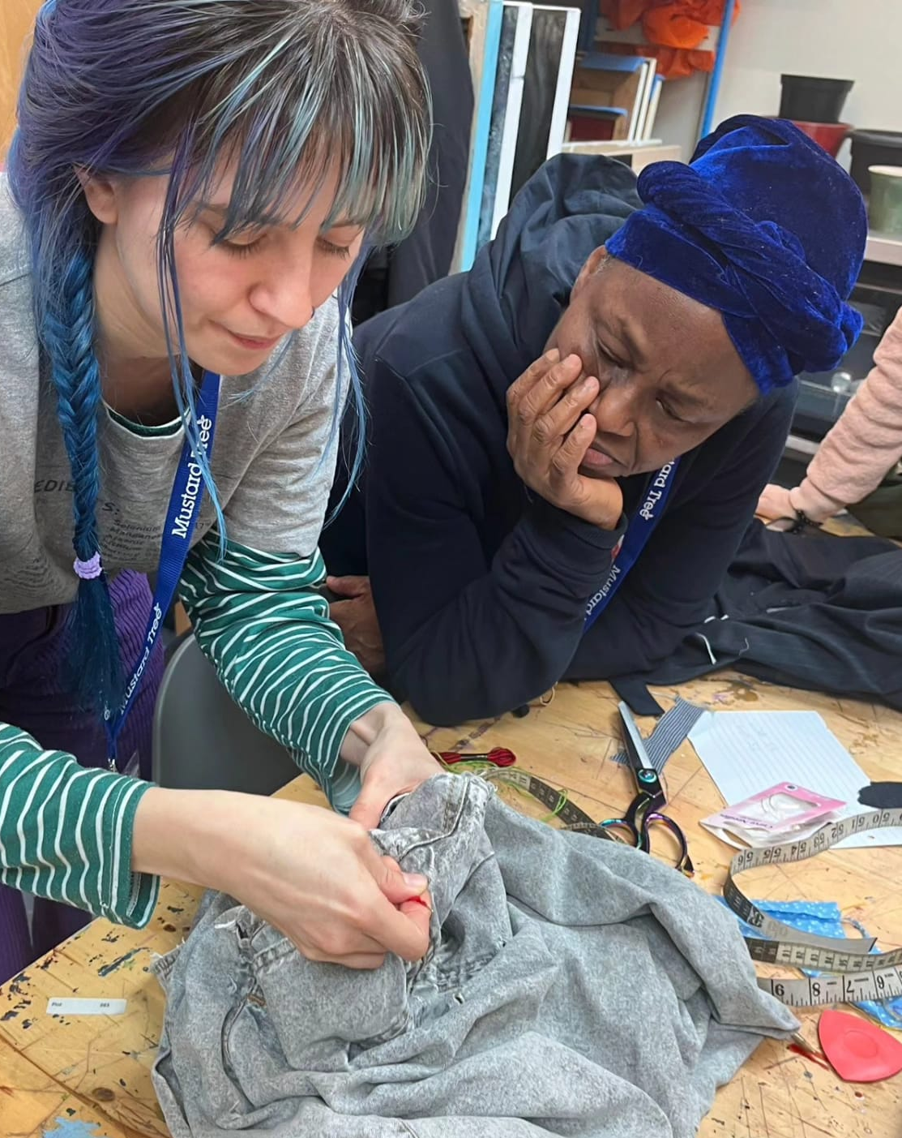
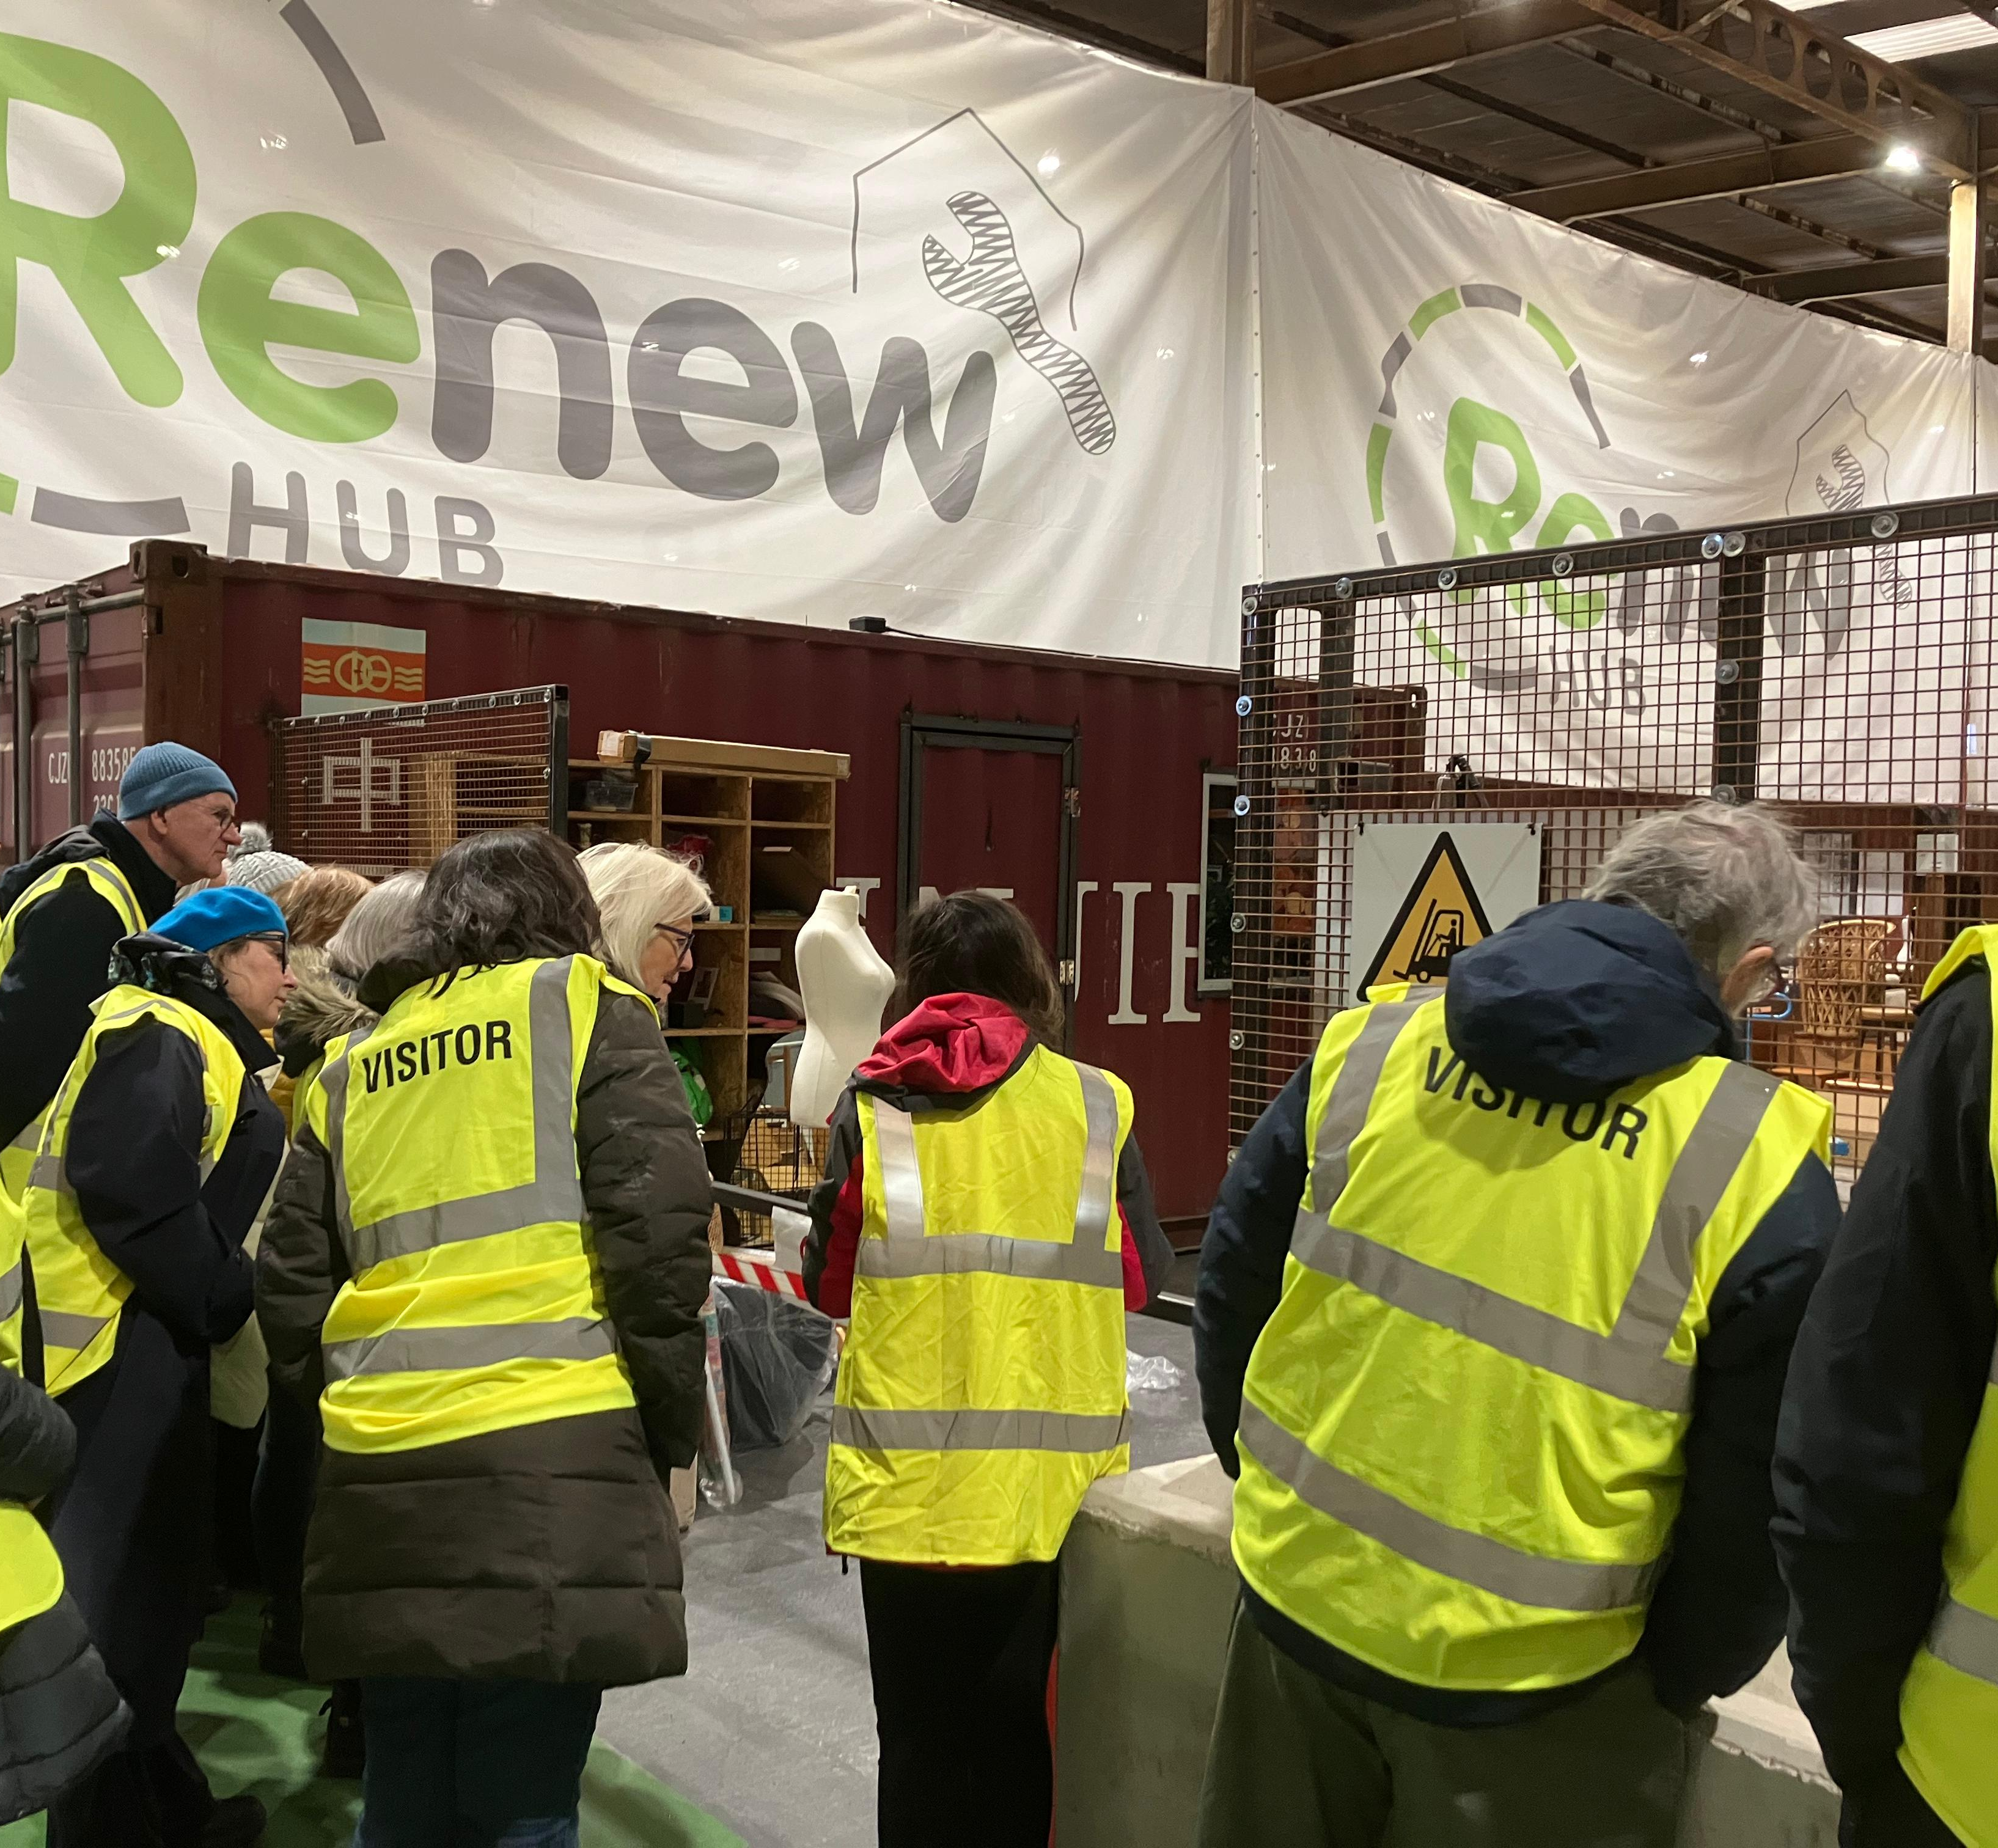
Building communities
Repair isn’t just about fixing.
It creates connections and promotes support in local communities.
We promoted 18 events in 2024 and
feedback showed the value hosts and attendees got from connecting with their local community at events.
Sharing knowledge and skills improves community cohesion. Repair Week 2025 will focus on amplifying these community connections.

Slide 4
Repair Week 2025
Event host benefits | Attendee/resident benefits
Meet new customers-2024 campaign reached 165,727 people | Find local repairers
Be part of a local and national campaign | Save money by repairing instead of replacing
Free advertising of event listings | Connect with local groups and neighbours
Free listing on R4GM’s Repair Directory | Quick fixes
Network with other repairers | Learn new skills
We’re asking repair groups and businesses to host events which we’ll promote to residents to:
Celebrate repair organisations in our communities
Encourage residents to try repair to learn new skills
Demonstrate the crucial role repair plays in the circular economy by making things last longer
Expand Repair Week awareness
Grow the repair directory
Support communities

Slide 5
Greater Manchester Repair Directory
To make it easy for residents to find and use repair services we created a local repair directory. This sits on the R4GM website and is available all year round.
Any community group, business or training provider who repairs can be listed for free.

Slide 6
Repair Week 2025 timeline (R4GM)
2020 - campaign started by ReLondon
2024 - R4GM became an official partner, bringing Repair Week to Greater Manchester
2025 - Durham, Cardiff, Merseyside, Belfast join as official partners
December
Launch event sign up
Reach out to community groups and business to host events
January
Final push for sign up
Paid advertising
Sign up closes 31st Jan
February
Promote events to residents
Event webpage live, social media and paid adverts
March 3rd -9th
Repair Week 2025
Promotion of events via socials, press release
🔧
🔧
🔧
🔧

Slide 7
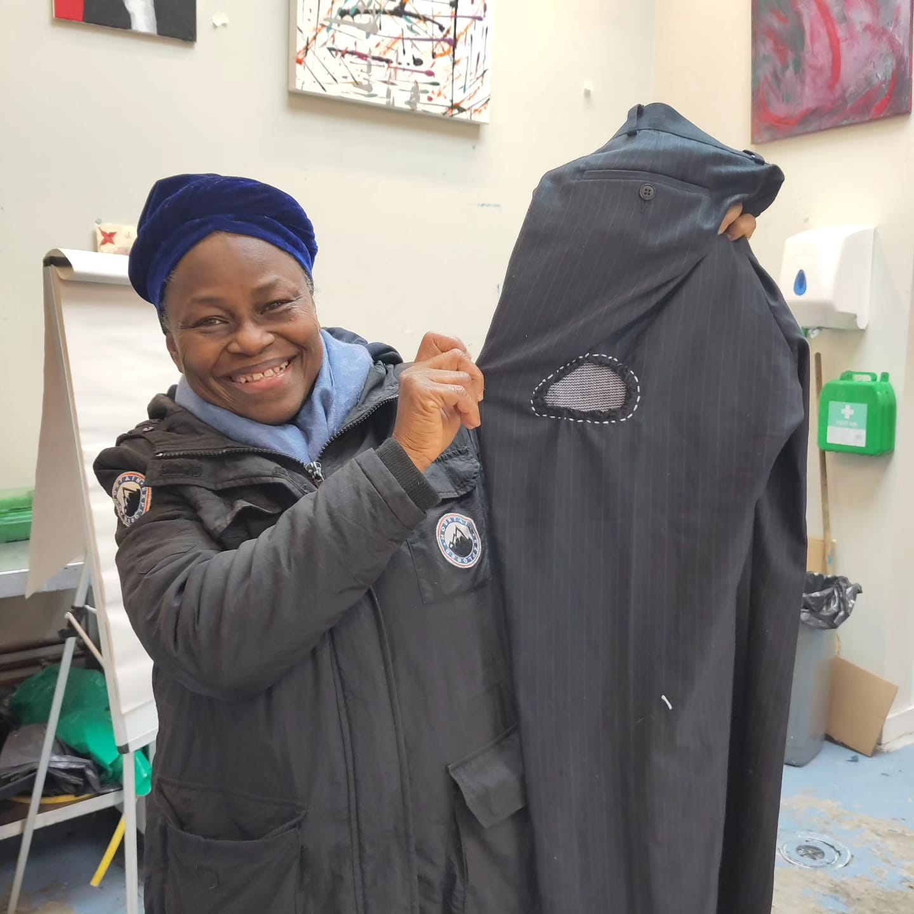
Be part of Repair Week
Share the campaign with local groups and businesses
Promote local repairers and events
Direct residents to the repair directory
Host an in person or online repair event
Highlight the importance of repair for making our stuff last longer and protecting our planet
For questions and support requests please contact: ellie.preston@greatermanchester-ca.gov.uk

