Slide 1
Salford Together Partnerships Lead
Bruce Poole

Slide 2
Partnerships Lead
Bridge between VCSE sector and Salford Together
Ensure voice, representation and influence
Identify, Enable and Facilitate opportunities for collaboration
Link VCSE organisations into Salford Together
Support the implementation of the MOU between VCSE and Salford Together
Notes:
A new role funded by the partners in Salford Together - I’ll explain that shortly
Develop relationships between voluntary, community and social enterprise sector and Salford Together
Identifying representatives who can Making sure we have strong representation and influence – through training, resourcing
Identify opportunities for collaboration and innovation across the sector
INVOLVE us
INCLUDE us
COLLABORATE with us
And recognise the VALUE of the sector

Slide 3
Working together to integrate care in Salford
Notes:
So who are ST?
partnership of org’s to transform the health and social care system integrating health and social care, bringing the services of GPs, nursing, social care, mental health, community based services and voluntary organisations also known as the Integrated Care Organisation / Division

Slide 4
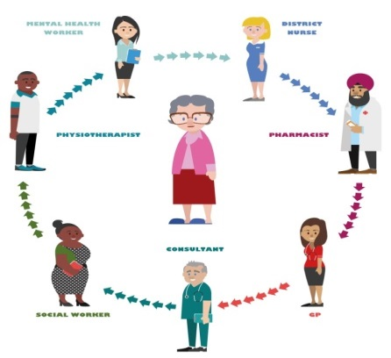
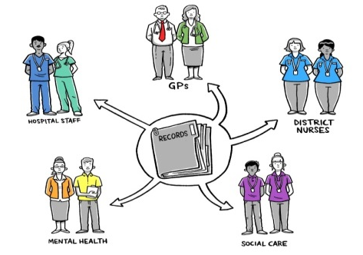
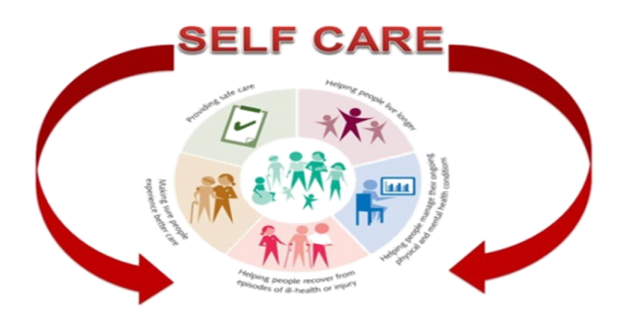
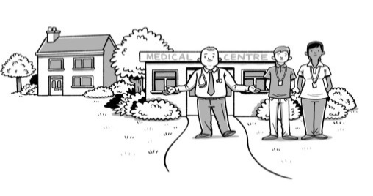
Transformation of Health and Social Care in Salford
Improving access to GP and community services
Sharing information
Neighbourhood Teams
Services that can help at home or in the community
Improving Care Pathways
Maximising independence
Notes:
And what are they doing ?
Exploring new ways of working – help people stay at home longer, reduce visits to hospital, improve self care and wellbeing
Bringing NHS Community Health Care workers together with social care wokers,
Working with a wider set of organisations, including those of us in VCSE sector
You may be familiar with some of the other projects that sits inside this = Falls Prevention (improving care pathways), Salford Wide Extended Access (improving access to GP and community services)
Some of the key areas of transformation Care Nav and Enghanced Care

Slide 5
Driven by design principles
Person Centred
Co- creating
Doing with, not for
Self Care
Just enough support when needed
Promoting Independence
Asset based approach
Notes:
The ICO

Slide 6
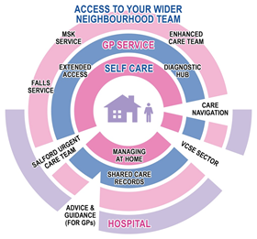
VCSE role – part of the ‘system’
Notes:
The ICO

Slide 7
How would you like me to work with you?
Hot topics
How do the reps and I champion the work of VOCAL and the Sector?
What do you need in terms to support?
Notes:
A brief overview -

